Slide 1
Safety Updates and Incident Summary
CCE Safety Committee Meeting
Nate Siladke
October 12, 2023

Slide 2
General Updates
PFD Inspections for 2023: Braun, Noyes, Spalding (November 2), and Schlinger (November 7)
  Trying to complete EH&S inspection prior to PFD inspection
Hazardous Waste Online training: please encourage lab members to complete. Annual requirement
2023 Inspection data shows three trends to focus on:
  Glass waste issues
  Damaged/contaminated Lab Coats and eye protection requirements
  Refrigerator/freezer storage issues

Slide 3
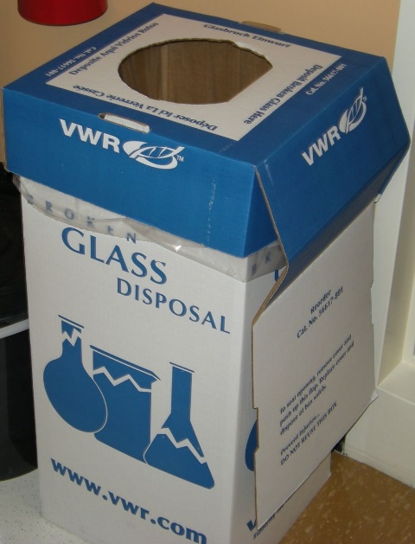
Glass Waste
During 2023 inspections, there has been a large uptick in finding glass waste containing chemicals
Glass waste procedure
No chemicals (rinse three times) and must be empty
Deface bottle labels
Once full, close and tape lid
Mark as “Ready for Pick-up”
Position by lab entrance
Custodians will remove
These go into the landfill!

Slide 4
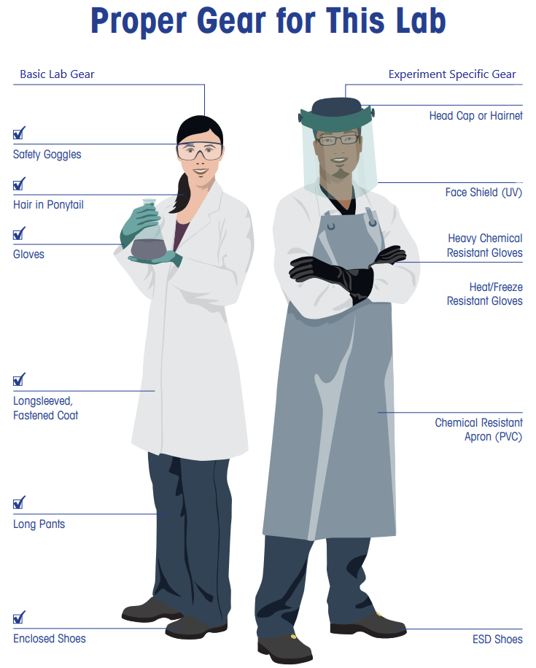
Personal Protective Equipment
Inspect all PPE before use
  Have been findings lab coats in use with heavy contamination and/or holes
  Laundry Service available through Division
  Lab coats obtained through the Division
  Eye protection required at all times in the lab: free from Division
Notes:
When you step into the lab, think about what you are wearing:
No skin exposed from the waste down when entering a lab. So long pants (or equivalent) and closed toe shoes required. Some labs also require the use of eye protection when entering a lab, so make sure to always check with a lab if they have specific PPE requirements.
Once working with hazardous material, put on appropriate PPE for the hazard being worked with. This commonly includes a lab coat, eye protection, and gloves.
Depending on the hazards, you may need additional PPE, such as the person on the right. A good example is dispensing liquid nitrogen, which requires the use of a face shield and cryogenic gloves
Always inspect your PPE prior to use to make sure it is not damaged, is not contaminated, and fits properly.
Ensure the gloves you choose to use are compatible with the chemicals being worked with. Some chemicals can go right through nitrile gloves! Consult the SDS and the lab manufacturer. EHS is also available to assist in determining gloves.
Respirator use in labs is very uncommon. For respirator use, you need through the safety office for medical clearance and fit testing. Do not buy your own respirator.

Slide 5
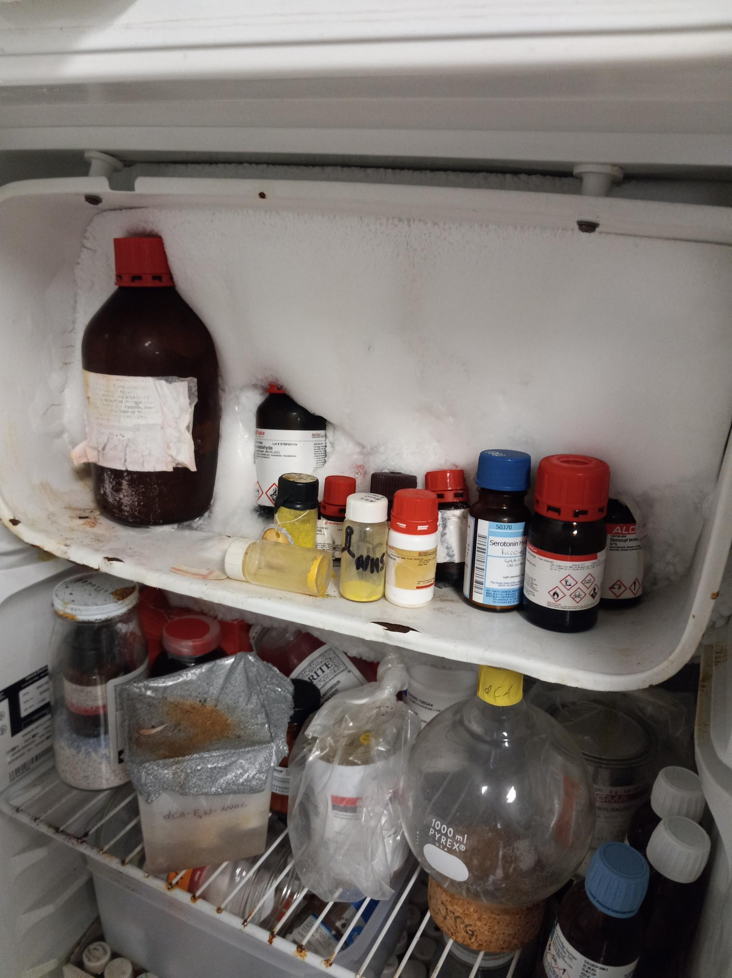
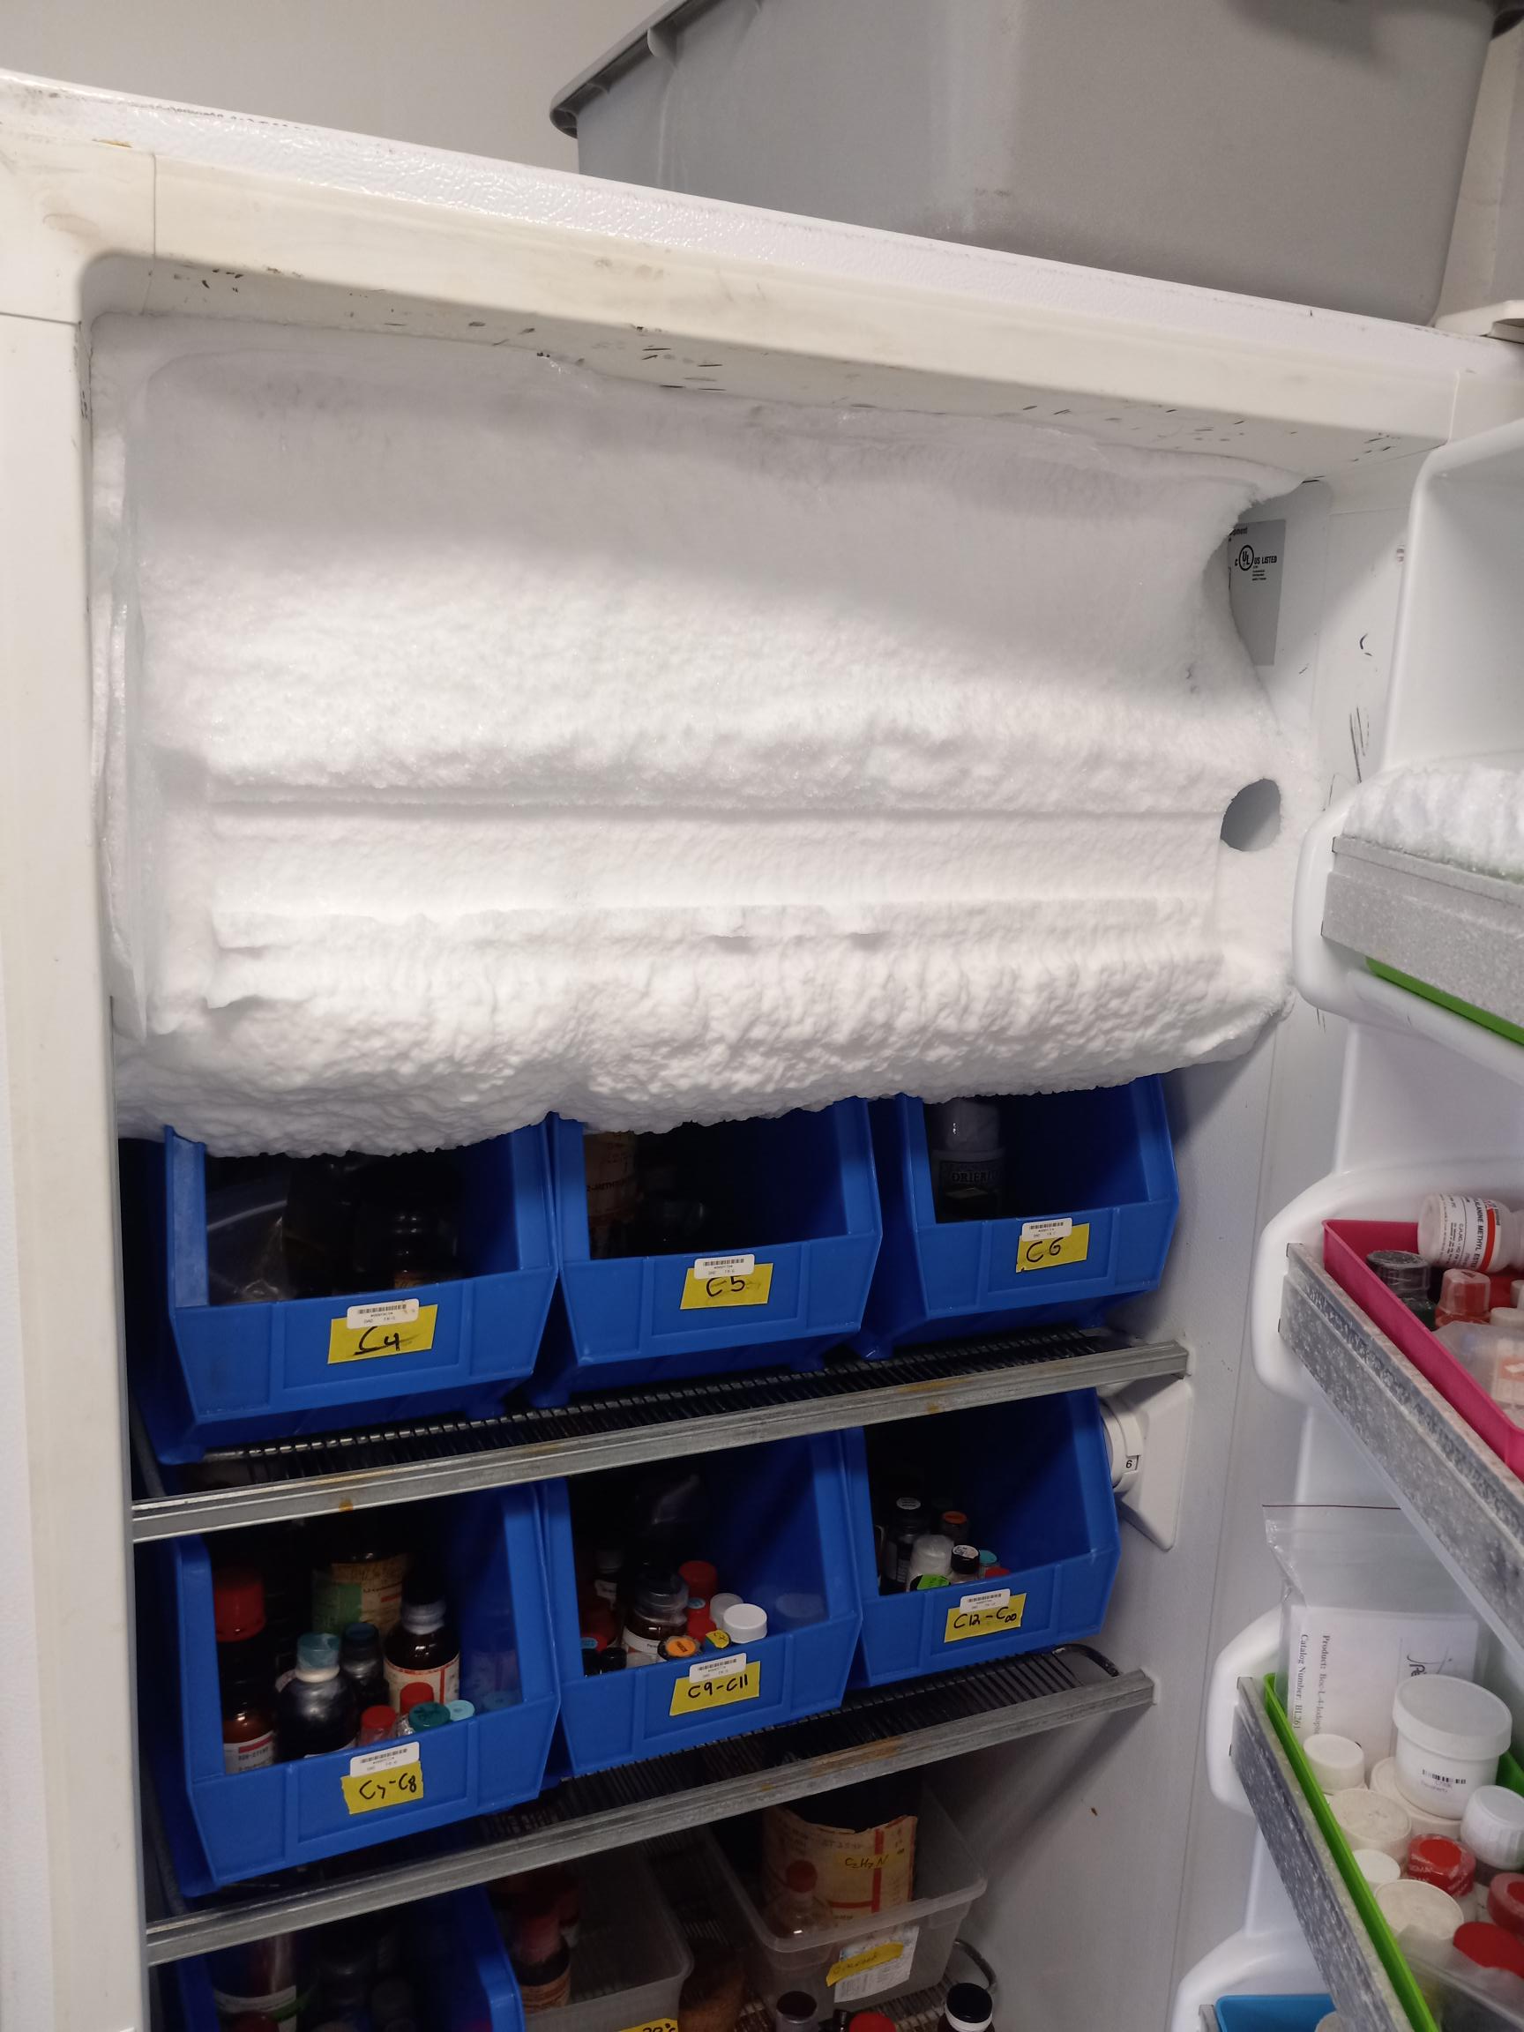
Chemical Refrigerator/Freezer Issues
Chemical refrigerator/freezer issues have increased this year:
Overcrowding and stacking of chemicals
Ice/frost issues (bottles encased in ice)
Strong odors: keep highly odorous and inhalation chemical bottles sealed, use parafilm, and consider using sealable secondary containers (only open in fume hood)

Slide 6
Onboarding New Researchers
Hazard Assessment-determines SOPs, review work with new researchers to ensure hazards of project are covered
Lab SOPs – used as a tool to train and onboard new researchers; sets standards in the lab
Documentation of in-lab training - can be Workplace Specific Training form or equivalent
Ensure EH&S trainings are completed: Most in CCE need at least Lab Safety Orientation and Hazardous Waste online training

Slide 7
Required Training from Safety Office
Find Training Matrix on Safety Office Website → Training tab
Safety Office offers additional trainings on compressed gases, liquid nitrogen, etc.
Notes:
To determine what training is needed from the Safety Office, please refer to the Training Requirements for Researchers Matrix.
You are currently taking Lab Safety Orientation, which is required and is listed on this Matrix
The hazards you are working with in the lab will dictate which training(s) you will need.
This matrix is available on the Safety website.

Slide 8
Required Training from Your Lab
Lab does NOT have to use this form, can be documented in anyway the lab prefers, just capture same information
Covers location-specific emergency procedures
Backside can be used to document lab-specific training
Form available on Safety website
CCE also has their own check-in form
Notes:
In addition to Safety Training from the Safety Office, your lab also needs to provide training to you.
To help you and the lab complete the lab specific training, the Workplace Specific Safety Training sheet should be used.
This document is to be filled out when you first join a lab and when your research requires you to work with new hazards.
This covers the basic emergency information that is specific to a particular location.
This also helps with documenting any Lab Specific training you may require, which is performed in the lab and by a lab member.
This is some of the most important training you will receive, but we have to make sure to document it!
Please complete this checklist, any of the required training, and maintain this document in your lab’s safety records.

Slide 9
Lab Safety and Leadership Workshop
Sabine Brinkmann-Chen: Lab Manager/Safety Coordinaotr for Arnold Lab
sabine@cheme.caltech.edu

Slide 10
Sharps injury/exposure prevention plan:
Due to an increase in sharps injuries on campus, including some reportable to the NIH, the Institutional Biosafety Committee (IBC) has requested that we (EH&S) implement a sharps injury/exposure prevention action plan.
Timeline:
Next 3-6 months:
  Train all the LSOs on sharps injury/exposure prevention and response so that they can train their labs
  First will be BBE: all labs
  Second will be CCE: labs with IBC protocols, but all are welcome and strongly encouraged to participate
Next 6 months:
  Develop a sharps injury/exposure prevention and response information page within the EH&S website
  Develop 1-page handout for posting and increasing awareness
Next 12 months (2024):
  Develop an on-line training module for sharps injury/exposure prevention and response

Slide 11
Incidents and Lessons Learned
Incident Type | October 2022 to Now
Chemical Spills | 9
Chemical Exposures | 4
Biohazard Exposure | 2
Reactivity Related | 5
Equipment Related | 4
Injuries | 3
Not every incident reviewed here. Other reported incidents include low hazard near-miss events, odor calls, facility issues, non-lab related minor injuries

Slide 12
Spills
Acetic acid spill during transport: dilute acetic acid bottle dropped in stairwell
  Root Cause: Bottle carrier not used, bottle slipped from hands
  Corrective Action: use carrier
Methyl triflate spill: small ampule of methyl triflate fell out of refrigerator when opened, vial broke
  Root Cause: temporary storage during glovebox clean out, not carefully secured in fridge
  Corrective Action: 1 mL spill flushed with water and cleaned-up, ensured other materials in fridge were secure
Hg Thermometer broke in incubator: thermometer accidentally broke, all Hg contained
  Root Cause: accidental breakage, using Hg thermometer where not required
  Corrective Action: verified no spill using Hg detector; replaced all Hg thermometers with alcohol ones

Slide 13
Spills
Chloroform in the sink: polypropylene centrifuge tubes degraded and leaked. Spill was contained in rotor and the spilled solution was then dumped into a sink with absorbent pads. Spill was not cleaned up well, so another researcher reported a chloroform odor to Security.
  Root Cause: Use of incompatible materials with chloroform, spill not cleaned up correctly, lack of communication
  Corrective Action: Use compatible materials, discussed clean up procedures and importance of notifying lab mates of incidents
Phosphoryl chloride bottle compromised: researcher found leaking bottle in refrigerator. Was stored in secondary container, so spill contained
  Root Cause: bottle damaged
  Corrective Action: lab able to clean up since contained, moved to fume hood. No further corrective action since lab had it all in place!

Slide 14
Chemical Exposures
Acid contact: Student was rinsing cell parts which had been soaked in acid. Student accidentally bumped the cell parts and some 5% v/v aqueous H2SO4 splashed their forehead. None reached eyes since they were wearing safety goggles.
  Root Cause: working too quickly, simple mistake
  Corrective Action: reminded lab mates of importance to work carefully even when doing routine tasks
Dilute bleach in eyes: While cleaning bacterial cultures, which involves adding 10% bleach, a splash occurred and got into researcher’s eye. Eye became irritated and researcher was not eye protection. No permeant injury
  Root Cause: splash from sink due to water pressure, not wearing eye protection
  Corrective Action: Lab discussed basic cleaning considerations and lab has revisited the CCE requirement to wear eye protection at all times while working in the lab.
Potential methanol exposure: researcher found 5 gallon drum next to fume hood with small amount of residual methanol present. Started to experience symptoms of exposure. Safety determined that over exposure was unlikely.
  Root Cause: Drum left open outside of hood and drum not properly emptied
  Corrective action: lab discussed proper disposal of solvent drums
Near-miss acetonitrile exposure: While cleaning out a fume hood, researcher came in contact with Hamilton syringe that was covered under paper towel. While they felt a poke, glove and skin were not broken. Syringe was also rinsed after use
  Root Cause: syringe was not stored properly after use
  Corrective action: lab discussed SOP for sharps, including storage. Will use blunt needles whenever possible

Slide 15
Bio Exposure
Waste exposure to eyes: While swapping out a flask that collects waste from a flow cytometer, flask was dropped and splashed upward and researcher’s neck, eyes, and face came in contact. The material had been dilute and deactivated prior to moving, so no bio exposure. No eye protection worn during this work.
  Root Cause: Waste was not sealed prior to moving it; no eye protection
  Corrective Action: close waste prior to moving it, wear eye protection even when performing routine tasks

Slide 16
Reactivity Incidents
Peroxide reaction: reaction flask spillover during dropwise addition of tert-butyl perbenzoate into refluxing benzene.
  Root Cause: based on OrgSyn Prep, but done at larger scale
  Corrective Action: reevaluate scale, done smaller and slower peroxide addition, perform risk assessment for scale ups
Quench fire: While adding diluted nBuLi dropwise to a quenching solution, the flask caught fire. Fire was put out with extinguisher
  Root Cause: Quenching pyrophorics without an N2 environment
  Corrective Action: Always use an N2 environment; No need to quench parent bottles-hazardous waste program accepts bottles in good condition

Slide 17
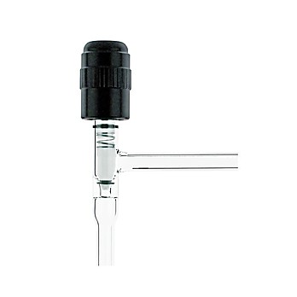
Reactivity Incidents
Flask Burst 1: Irradiation of the Schlenk flask with a chemical reaction using 390nm LED lamps resulted in breaking of the flask and chemical spill
  Root Cause: Flask was completely filled and sealed. Solvent expansion could build pressure in the flask causing it to break. One other possibility, although not expected from the chemistry, is the unintended formation of a gaseous by-product.
  Corrective Actions: Flasks used going forward will not be completely filled to allow for solvent expansion. For experiments where pressure may build from gas formation, a pressure relieving stop cock has been ordered and will be used for those experiments
Flask burst 2: Distillation of substituted propargyl bromide from crude reaction caused a runaway in the distillation flask. Flask burst, causing splash of material and smoke in the lab, which caused irritation to researchers so lab evacuated
  Root Cause: Performed at large scale, 2.75 mol scale (compared to 1.2 mol as previously done) without assessing additional risk from scale up.
  Corrective Actions: Risk assessment policy in lab for larger scale reactions. Using Laboratory Risk Assessment Tool-available on Safety website. Must use blast shield for larger scale reactions.
Pressure Relief Valve Complete (thomassci.com)

Slide 18
Laboratory Risk Assessment Tool
Walks through “What if” analysis of experiment to help identify mitigation opportunities based on risk
Available here: https://www.safety.caltech.edu/documents/14125/Laboratory_Risk_Assessment_Tool_062419.pdf

Slide 19
Equipment Related
Hot plate fire: Hot plate was accidentally turned on while oil bath on heating element, oil bath ignited. No injuries or damage, extinguished by researcher
  Root Cause: hot plate left plugged in
  Corrective Action: SOP to unplug all hot plates when not in use
Peroxide fridge failure: strong acetic acid like odor emitting from fridge. Researcher reported felling light headed
  Root Cause: peroxyacetic peroxide not sealed well; fridge seal had failed so was not closing completely
  Corrective Actions: Lab implemented better chemical storage and sign-out sheet for those chemicals

Slide 20
Equipment Related
UV light exposure: Student walking by a contained UV light set up was briefly exposed to the light because a fellow researcher did not turn the light off when opening the containment box. Student experienced eye sensitivity but no permanent injury
  Root Cause: procedure was not followed to turn light off before opening containment box; insufficient UV light protection for people around set-up
  Corrective Action: Interlock added to containment door so light automatically shuts off when door is opened; added additional light protection where needed

Slide 21
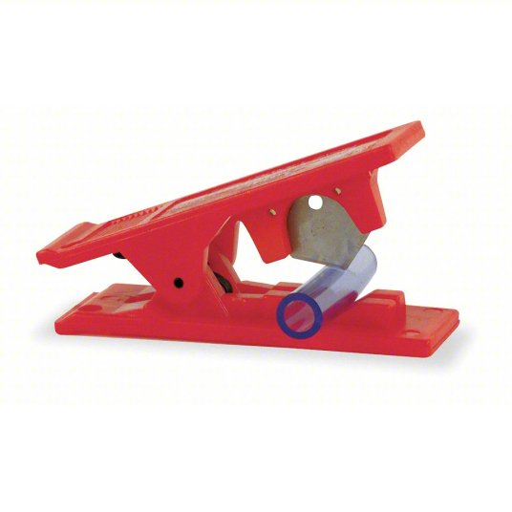

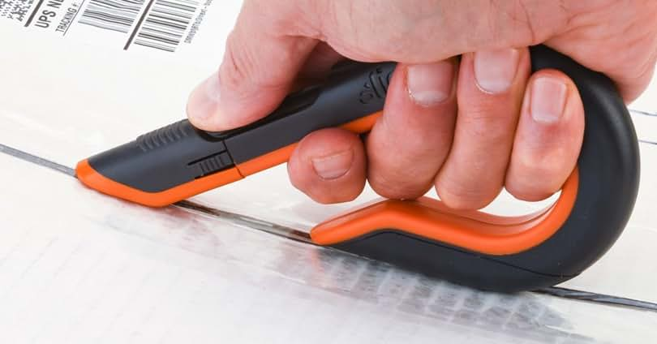
Injuries
Razor cut: Researcher cut thumb with a razor blade while cutting tubing
  Root Cause: lab using the wrong tool. Loose razor prevented a good grip, so the razor slipped while applying pressure to the tube
  Corrective Action: Lab has made everyone aware not to use loose razors for anything other than TLC plate prep. The lab has ordered handles for razor blades to improve grip and to help prevent slipping again.
  Specific tube cutters are available! We overuse loose blades!
Agarose burn: Researcher opened bottle of heated agarose without allowing it to cool, so built up pressure sprayed the liquid out and onto researcher. Minor burns
  Root Cause: did not follow protocol by allowing flask to cool and depressurize
  Corrective Action: Lab discussed and retrained personnel on proper agarose preparation

Slide 22
Overall Lessons Learned
Maintain refrigerators and store chemicals carefully, especially inhalation hazard chemicals
Even routine tasks carry risk! Do not become complacent
Use better and safer tools (engineer out the risk!)
Reaction scale matters A LOT-perform risk assessment anytime scaling up
Know the hazards and compatibilities of chemicals before you use them
Unplug hot plates when not in use and maintain good housekeeping
Always wear eye protection in the lab
No need to quench parent bottles of reactive chemicals
Rinse needles after use, use blunt tip whenever possible, store carefully

Slide 23
Questions/Comments?
Nate Siladke
nsiladke@caltech.edu
x2430

