Slide 1
Incident Summary for CCE
Academic Year 2017-current

Slide 2
Overview of Incidents
Incident Type | Total for Year | Total for current Quarter
Equipment related | 5 | 0
Chemical Exposure | 2 | 0
Chemical Spills | 8 | 5
Injuries | 1 | 0
Fires | 1 | 0

Slide 3
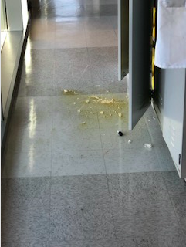
Chemical Spills
B-Iodo-9-BBN: Schlenk flask fell out of chemical storage cabinet when door was opened and broke on the ground. Spill generated HI fumes. No exposure or injury
Vanillin: mixture of vanillin in ethanol and 1% sulfuric acid fell out of flammables cabinet when door was opened. No exposure or injury
COD: Small quantity (10 mL) fell out of refrigerator when door was opened. Highly odorous chemical caused smell in entire building.

Slide 4
Lessons Learned from Spills
Proper response to incidents is essential for minimizing impact from spills
Perform regular clean outs/purge old or unused chemicals
Store chemical containers in a secure manner (utilize secondary containment, do not stack containers)
If a spill occurs and there is an inhalation risk or odor, secure area and close doors to lab, evacuate if necessary
EHS to notify Division asap so that building occupants can be notified of spill if it may affect them

Slide 5
Chemical Waste Spills
Broken waste container: Glass container broke, possibly from being struck, spilling contents into secondary containment. Contained in a fume hood
-Ensure waste areas are not overfilled
-Use secondary containment for waste
Broken waste container: Glass container broke in flammables cabinet for waste accumulation. Likely broke due to internal pressure from being overfilled with solvent and/or from collecting cooled solvents.
-Lab response was excellent
-Only fill waste containers to 90 percent capacity
-Do not add cold solvents to waste container and seal

Slide 6
Lessons Learned
Overall lesson learned: Need to establish a culture where researchers identify hazards, assess risks, and mitigate those risks prior to doing work. Safety in not an ‘extra’, it’s integrated into the way we do research
ACS Risk Assessment video: https://dchas.org/2018/06/11/dchas-lab-risk-assessment-video-available/
Housekeeping (clutter, proper storage, purge unneeded chemicals, waste management) must be maintained for a safe environment

Slide 7
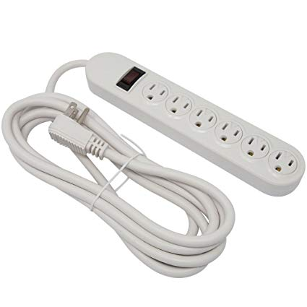
PFD: Power Strip Use in Labs
PFD recently informed Caltech that power strips used inside of fume hoods must be rated for use in a flammable environment
-The common commercial power strip does not meet these requirements
-No longer can just elevate power strip
-Can have power strips outside of the hood as long as other safety aspects addressed (overloading, secure away from liquids/spills)

Slide 8
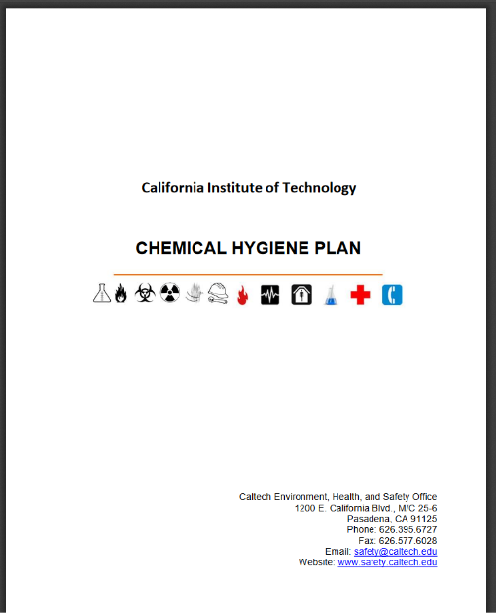
Updated Chemical Hygiene Plan
An updated campus Chemical Hygiene Plan is posted on Safety’s website:
https://www.safety.caltech.edu/documents/28-chemical_hygiene_plan.pdf
Lab members need to know how to access document and need to know sections that apply to them

