Slide 1

Notes:
Making virtual community – getting people together
2 groups of 19 people each
Social aspect of trying to check in with people
Some things that houses would normal do
Something planned to meet with them once a week
Returning and brand new – 6 or 7 of them are returning – the rest are new --

Slide 2
What We Do:
The Caltech Center for Inclusion & Diversity (CCID) mission is to provide education, advocacy, and allyship in order to increase institutional and personal capacity for diversity and ensure a community committed to equity and inclusive excellence. We create and implement campus-wide initiatives and programs that will increase the knowledge, skills, and attitudes for all members of the Caltech community to thrive in a diverse world.
Awareness & Education
Advocacy through Collaboration
Allyship

Slide 3
Caltech Center for Inclusion and Diversity
Cindy Weinstein / Chief Diversity Officer / caw@caltech.edu
Lindsey Malcom-Piqueux / AVPfor Diversity, Equity, Inclusion, and Assessment / Malcom@Caltech.edu
Taso Dimitriadis / Associate Director - Non Clinical Confidential Resources / taso@caltech.edu
Monique Thomas / Program Coordinator / mlthomas@caltech.edu
Alison Program Coordinator / Program Coordinator / atom@Caltech.edu
Marlene Moncada / Department Administrator/ mmoncada@caltech.edu

Slide 4
2020-2021 Theme: NAVIGATE
STEMinars
Cultural Heritage Months
Current Events
Alumni Connections
Professional Development
Resources

Slide 5
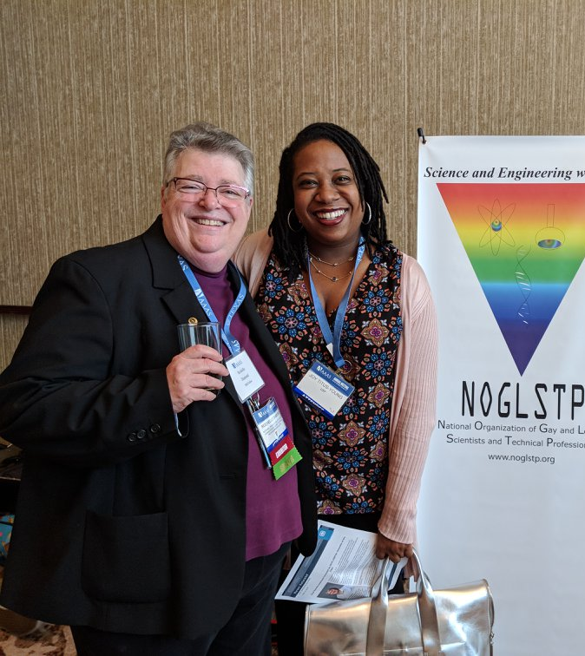
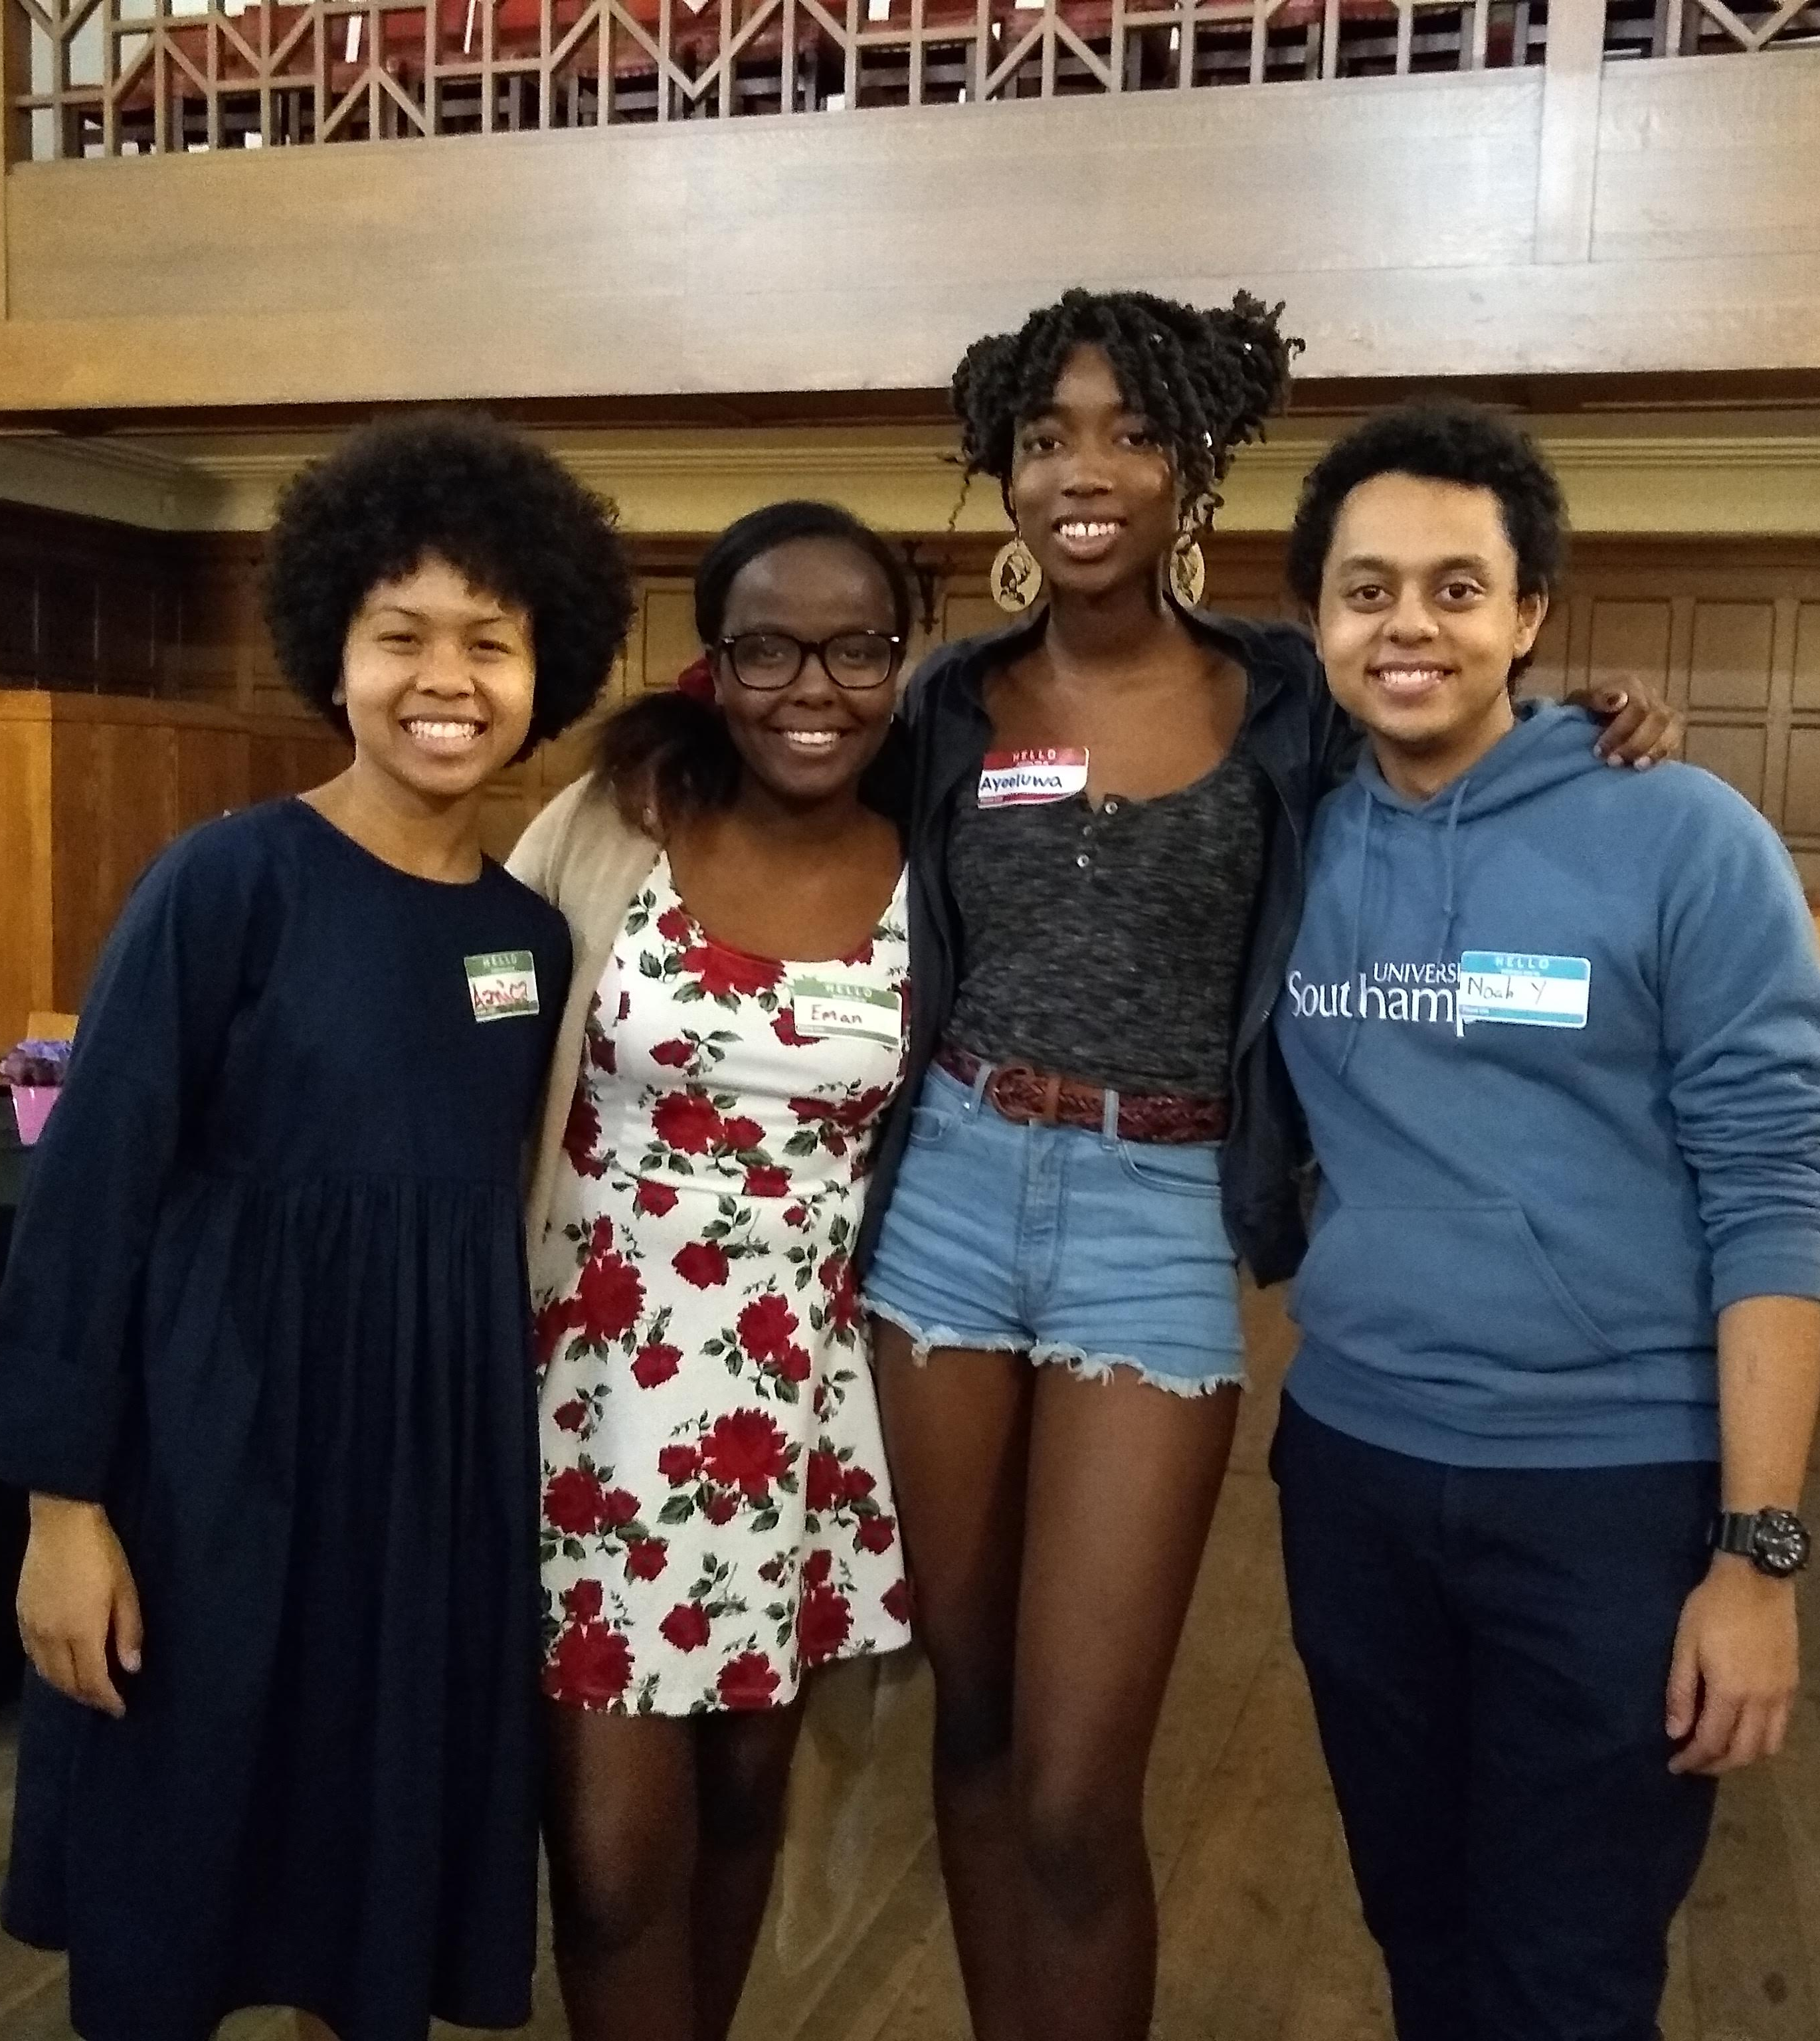
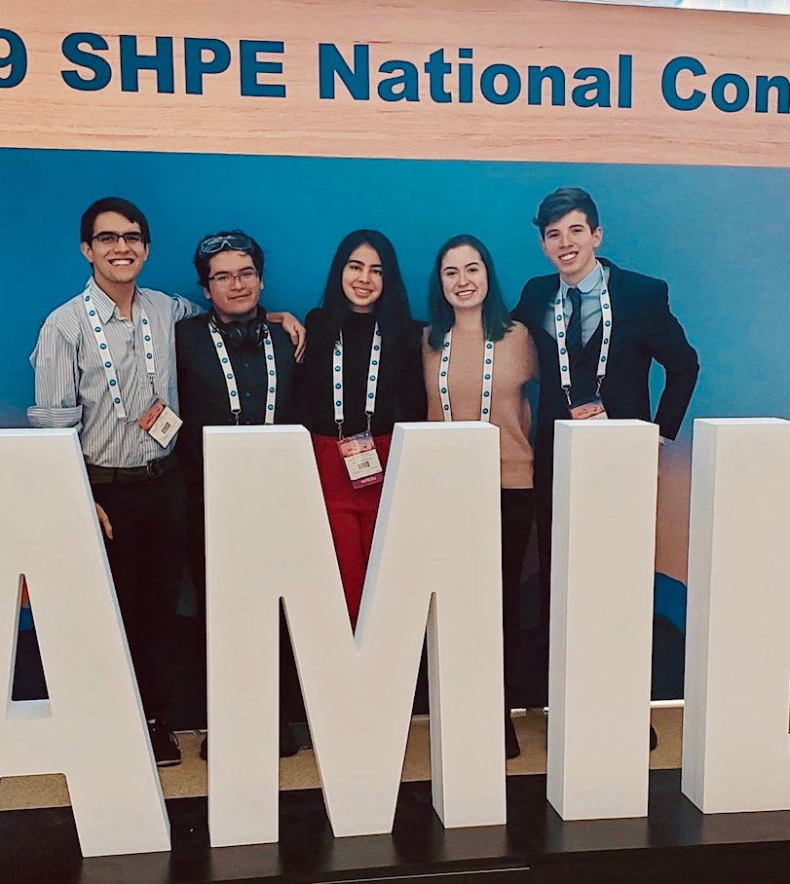
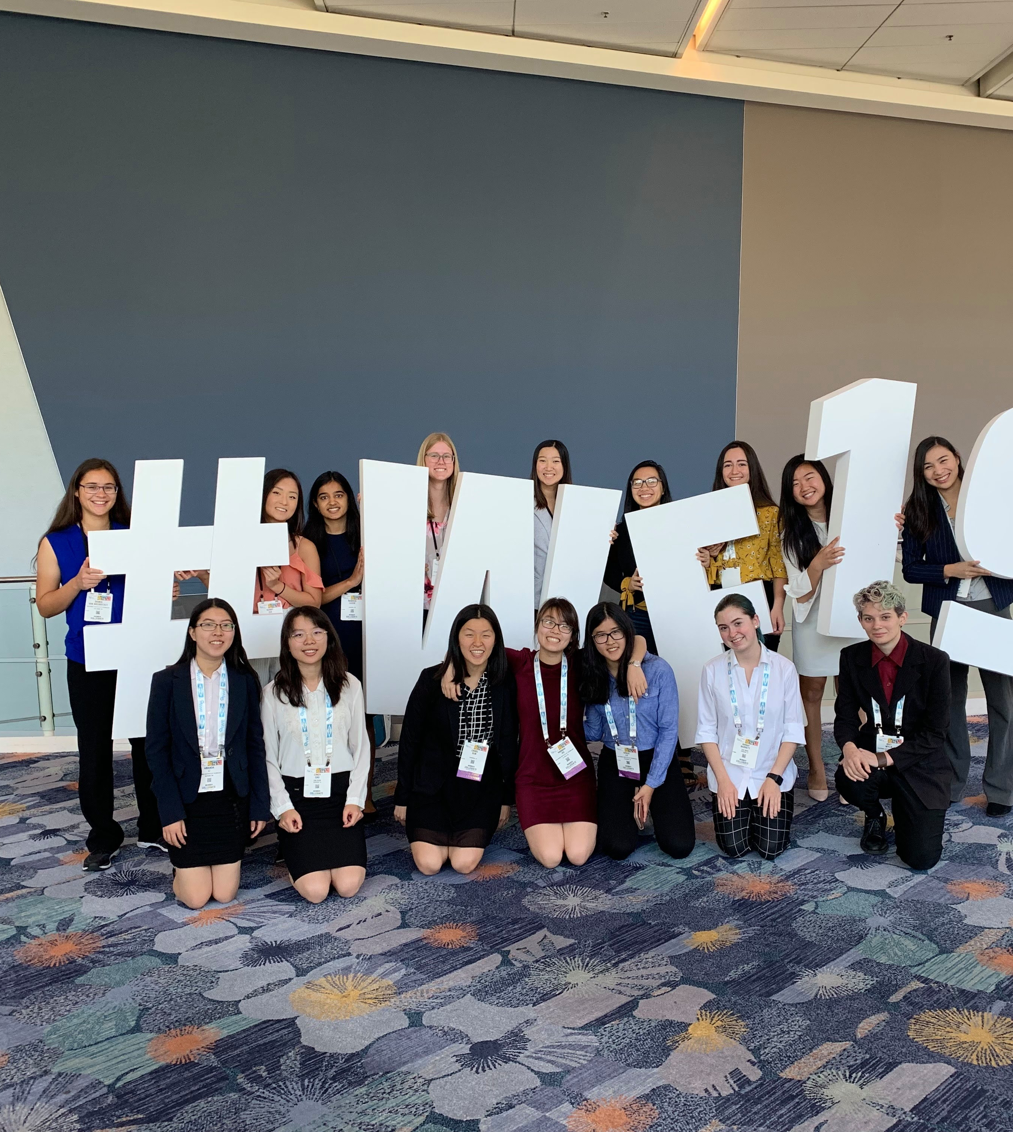
Clubs &
Affinity Spaces:
AAPI+: Asian American & Pacific Islander +
BLAC: Black Ladies at Caltech
BSEC: Black Scientists & Engineers at Caltech
Caltech Feminist Club
Club Latino
Techers of Color
Grad/Postdoc Women
PRISM: LGBTQ+ Community
Relate: Fueling Healthy Relationships

Slide 6
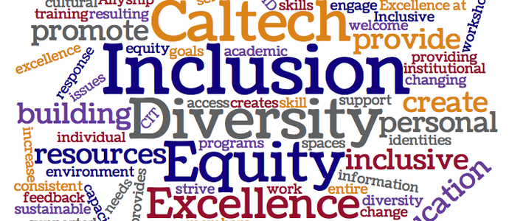

CCID General Trainings
Safe Zone Training
Decoding Diversity
Caltech Safe Zone Program ("Tech Zone") is to continue to foster an affirming and engaging campus climate by identifying and educating members of our campus community who are visibly supportive of lesbian, gay, bisexual, transgender, intersex, queer, and questioning students, as well as all individuals regardless of sexual orientation and gender identity
The Fundamentals of Designing an Inclusive Community is our new one hour workshop introducing all of campus to basic knowledge around diversity and inclusion.

Slide 7


CCID Initiatives
Caltech Diversity &
Inclusion Ambassadors
Compass
Mentoring Program
Caltech Diversity & Inclusion Ambassadors are individuals who align with the Caltech Center of Inclusion & Diversity's mission and vision towards greater education, action and allyship and participate in a series of trainings while developing their own diversity statement and advocacy project.
Strong mentors are critical in the development of at all levels in science, technology, engineering, mathematics (STEM). The Compass Mentoring Program is an identity-based initiative that seeks to match individuals with similar identities in their personal, social, academic and professional endeavors at Caltech and beyond.

Slide 8

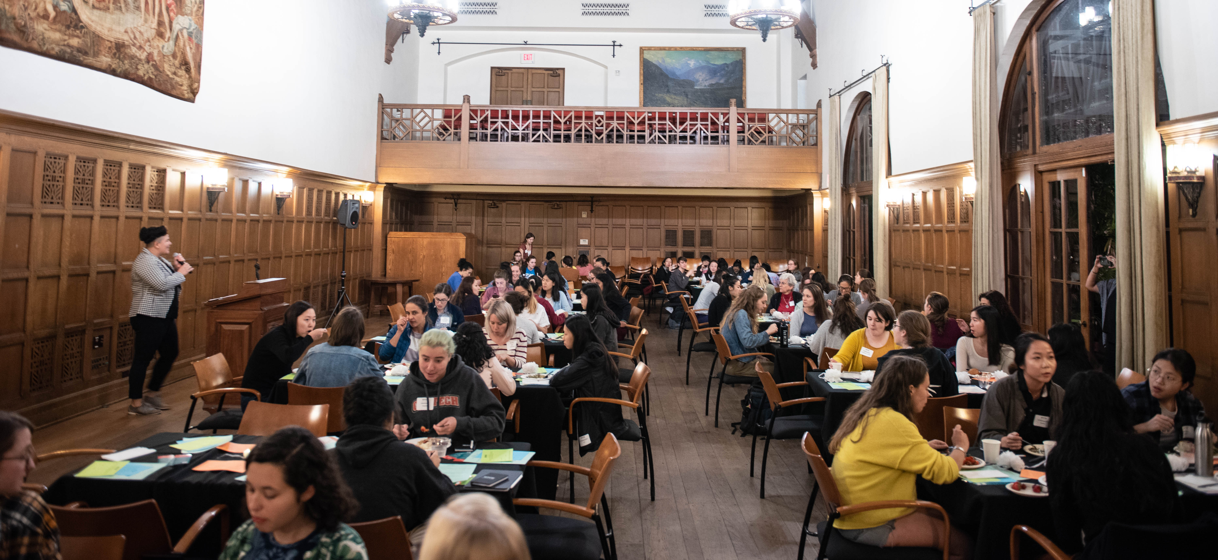
Women’s Programming
Women’s specific groups in every division that make up the Women’s Engagement Board
Chen Institute of Women in Neuroscience
Women in Biology and Biological Engineering
Women in Geological Sciences
Women in Chemistry
Women in GALCIT
Women in Physics, Math and Astronomy
Women in Mechanical and Civil Engineering
Women in Computing and Mathematical Sciences
*We use an inclusive definition of women, which includes trans women and is designed to be a feminine-centered space.
Notes:
Women o

Slide 9
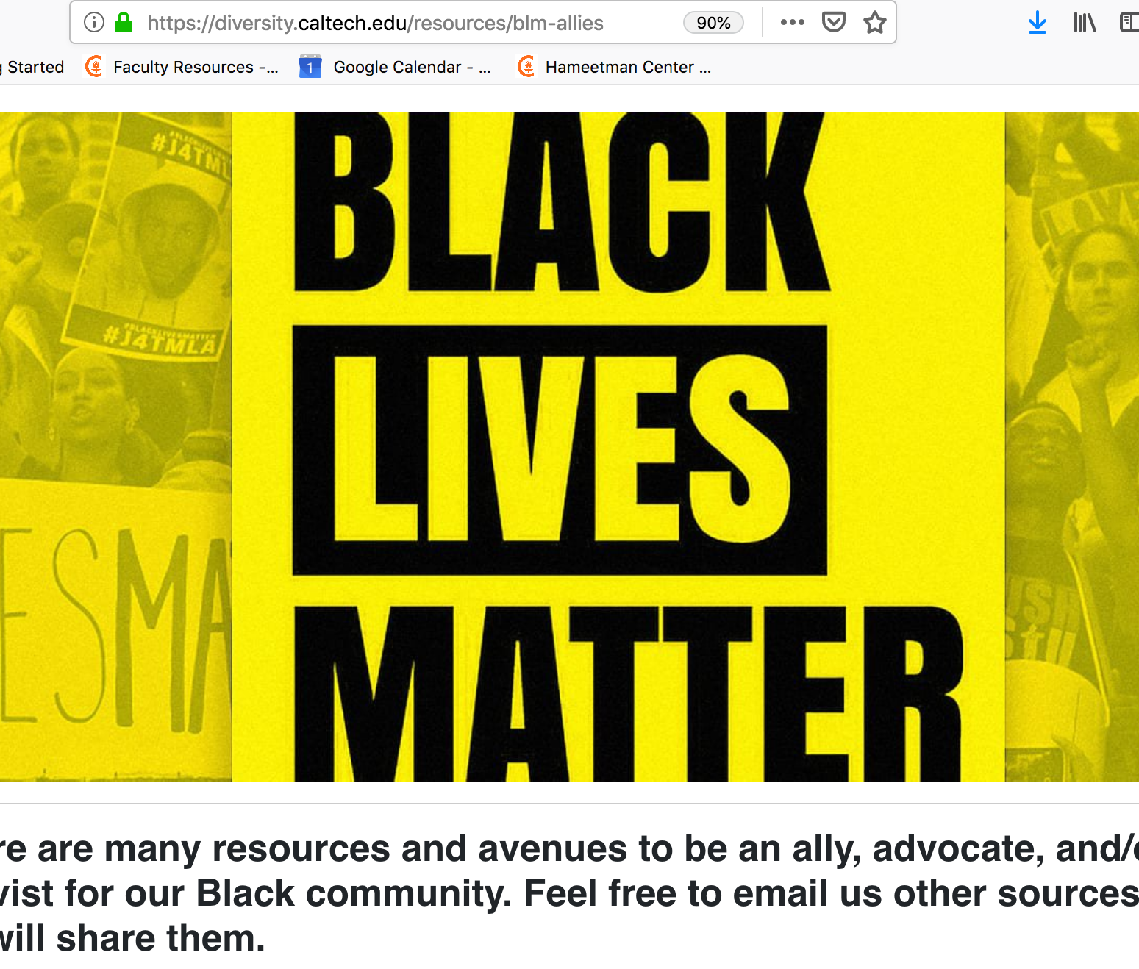



Contact us & utilize our resources:
Sign up for our newsletter!
diversity.caltech.edu
@CALTECHDIVERSITY
@CaltechCcid

