Slide 1
Incident Summary for CCE
CCE Safety Committee Meeting
February 6, 2020

Slide 2
Overview of Incidents
Incident Type | Total for current Quarter | Total for current Academic Year
Equipment related | 0 | 1
Chemical Exposures | 1 | 1
Biohazard Exposure | 0 | 0
Chemical Spills | 0 | 1
Injuries | 1 | 1
Fires | 0 | 0
Current Quarter: November 6, 2019 to present
Academic Year: September 2019 to current

Slide 3
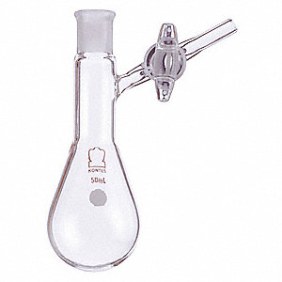
Chemical Exposure
Researcher was pumping a side-arm flask containing 5 mL of tert-butylamine into glovebox
Another researcher working near the glovebox could smell the amine
-Researcher did not experience any symptoms of over exposure (outlined in the SDS)
When flask was brought into box some time later, about 2 mL of the amine had been lost
-Flask was not under vacuum in antechamber, causing a leak
-Best to use sealable Strauss flask, but can use partial fill/partial vacuum with antechamber to prevent leak
-Glovebox vacuum pump exhaust not connected to building exhaust

Slide 4
Animal Bite-Injury
Mouse had not been used in any experiments (no laboratory biohazards)
Lab procedure required the use of double-gloves, but the researcher only had one pair
Researcher admitted to being complacent
-Complacency in the lab, especially around repetitive work, is a common cause of incidents
-If a procedure is needed, work with Faculty/lab members to develop one

Slide 5
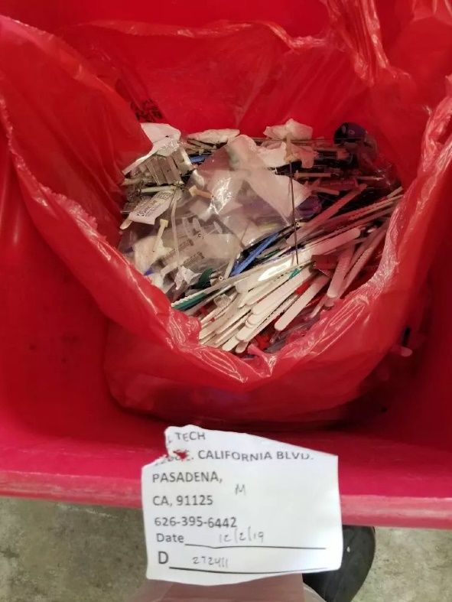
Near Miss Events
Abandoned samples in Church and Noyes
-Church: small sealed sample vials left in employee’s mailbox
-Noyes: samples left in copier room
Caused concern, Security was involved
Owners of samples eventually found
-Bring samples directly back to lab
Improper Sharps Disposal
No injuries
Received letter from waste company

Slide 7
Lab Specific Training Elements
ID Hazards
Develop SOPs
Train
Document Training
Update as lab changes
Notes:
ID Hazards: We must identify hazards in the lab to serve as basis for needed training (can use EHS Hazard Assessment for this)
Develop SOPs: Need standards and procedures for lab work and serves as a training tool (CCE SOP library and EHS general procedures)
Train: Use SOPs, hands-on demonstration, observe trainee to verify they have acquired skill/knowledge
Document: Training must be documented (Use EHS Workplace Specific Orientation)
Update as lab changes: New processes, equipment, procedures, may mean new hazards! Start cycle again

