Slide 1
Incident Summary for CCE
Academic Year 2017-current

Slide 2
Overview of Incidents
Equipment related: 5 minor, no injuries (2 non-events)
Chemical exposures: 2 minor, no injuries
Chemical spills: 3 occurred, no injuries
Cuts/Injuries: 1 incident
Fires: 1 incident, no injuries
Overall lesson learned: Need to establish a culture where researchers identify hazards, assess risks, and mitigate those risks prior to doing work. Safety in not an ‘extra’, it’s integrated into the way we do research

Slide 3
Equipment Related Incidents
H2 detector in alarm; Phosphine detector in alarm
-Calibrate and maintain detectors
LN2 tank valve left on overnight
-Check lab before leaving for the night
Glassware drying rack fell off of wall
-Carpenter shop assessed all wall racks
Reaction flask broken prior to quench
-Check all glassware for defects before using

Slide 4
Chemical Exposures
1,2-dichloroethane exposure-needle became detached from syringe during transfer. A few drops landed on researcher's face and rolled into eyes. Eye protection was safety glasses over prescription, so large gap.
-new student, mentor to more closely monitor
-wear proper PPE that fits
-ensure needles are affixed securely to syringes and use parafilm to wrap and secure needles
-pay attention to back pressure and force placed on a syringe
Base bath exposure-researcher dropped flask into bath when it slipped out of tweezers. A few drops landed on face and rolled into eyes
-use proper equipment, tongs for holding flask vs. tweezers

Slide 5
Chemical Spills
2-Mercaptoethanol bottle dropped: small spill was cleaned by researcher, but debris thrown in trash
-dispose of clean up material properly
-close doors to lab, lab under negative pressure
Overflowed quench of diethylaluminum cyanide: ice used as quench reagent, flask overflowed in fume hood
-quenching needs to be a controlled reaction, group to develop proper quenching protocol
4L bottle of dichloromethane dropped: researcher was restocking bottles when it slipped out of hand. Researcher cleaned up spill by themselves, then reported incident to Nate.
-Do not clean spills where respiratory protection is needed
-Notify others in the lab and evacuate, post signage
-Call security at x5000 to report spill
-In this case, we would have just let it evaporate

Slide 6
Cuts/Injuries
Lacerations to several fingers: while trying to remove glass adapter from rubber tubing, glass broke and cut researchers hand
-design out hazards and risks (do not use glass adapters, use metal ones if possible)
-do not force glass
-cut tubing to remove fragile objects

Slide 7
Fire
Sealed reaction flask failed, leading to fire that was contained in fume hood but exacerbated by other materials in the fume hood.
-in general, should not seal heated reaction flasks
-hazard analysis for all reactions, especially unattended
-fume hood housekeeping, remove all unnecessary items (waste)

Slide 8
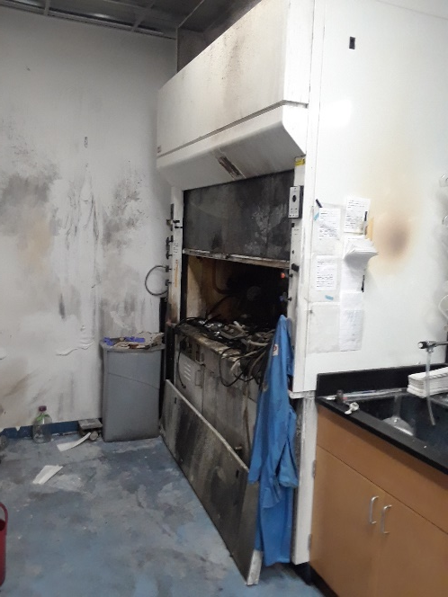
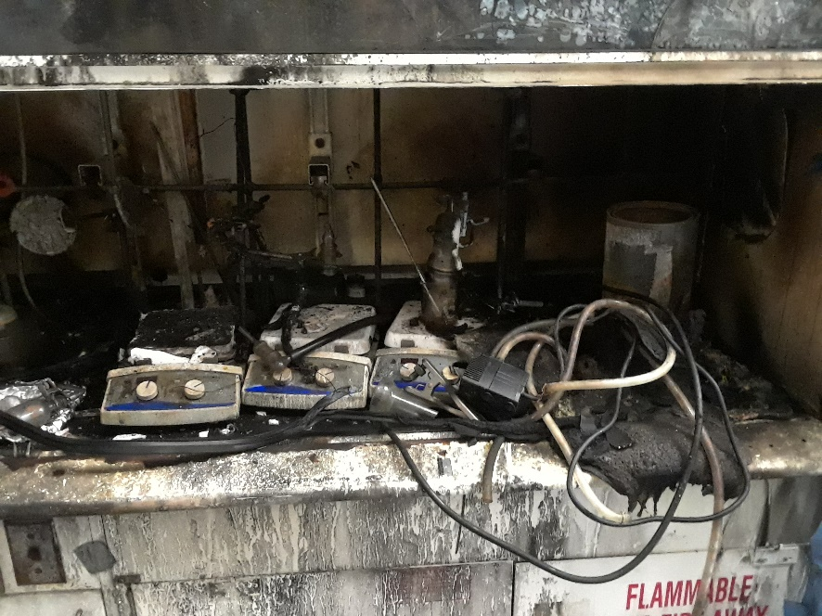
Fire

Slide 9
2017 CCE Top Findings
Incompatible chemical storage (41)
Unlabeled containers (27)
Electrical safety issues (27)
Seismic security (23)
Deficient housekeeping (17)

