Slide 1
A supportive community of women* within the division connecting members across all stages in career and walks of life with resources for personal and professional growth. We achieve this by:
promoting professional development,
facilitating meaningful mentorship and networking, and
advocating for broader support of our community members.
We use an inclusive definition of "woman" and "female" and we welcome trans women, genderqueer women and non-binary people. We believe in supporting the many intersections of our members' identities, such as (but not limited to) race, sexual orientation, gender expression, socioeconomic class, and immigrant/indigenous status.

Slide 2
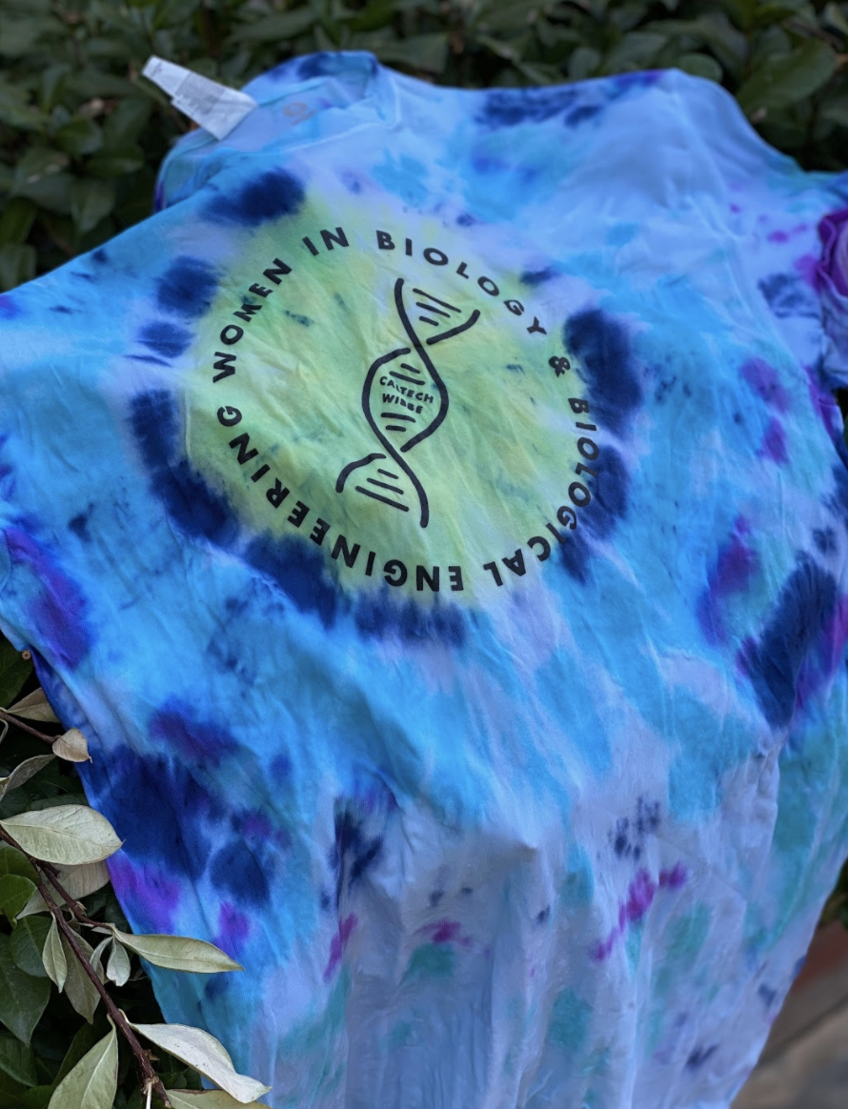
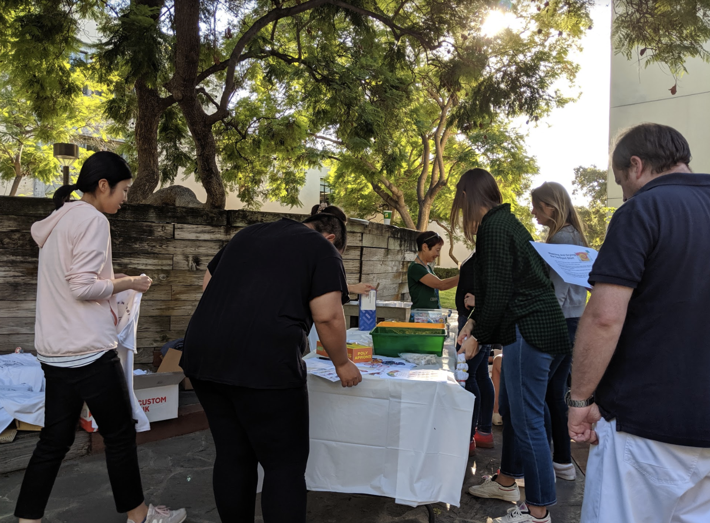
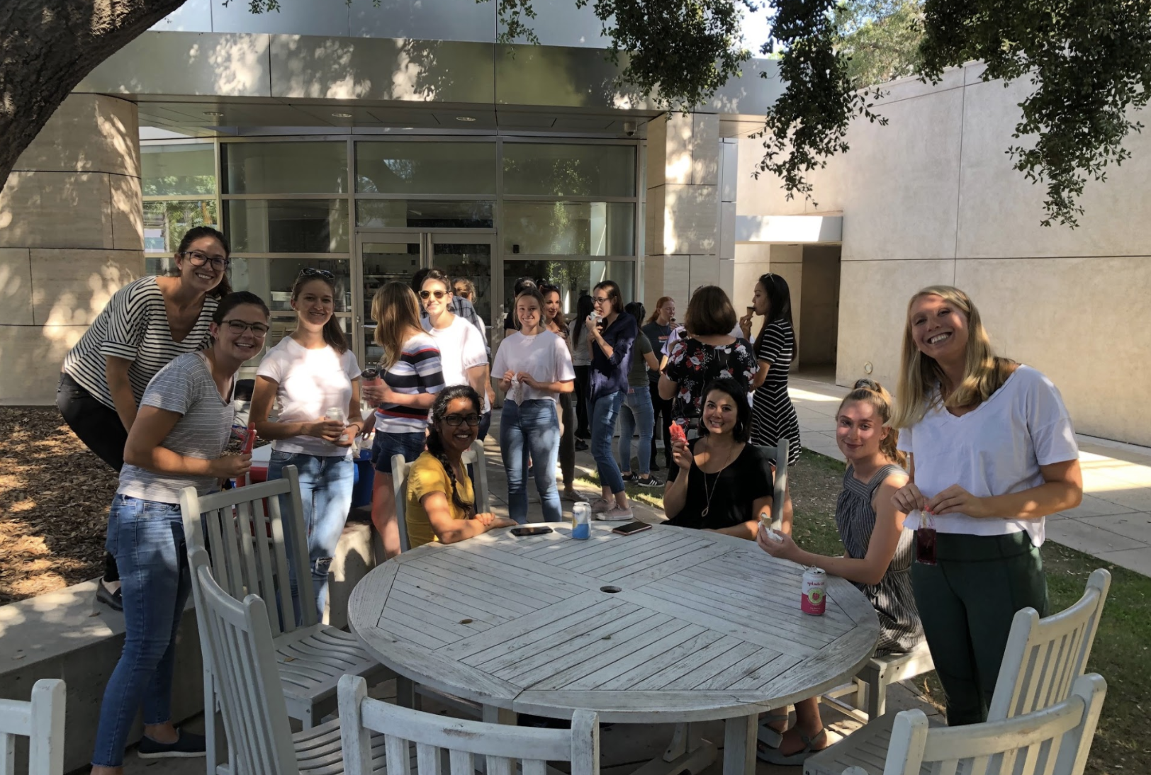
What do I get as a member of the WiBBE community?
WiBBE and Friends Ice Cream Social
Family Tie Dye Event 2019
Virtual Chinese New Year
Programs and Resources:
1-1 Mentorship Program
Postdoc and New Student Welcome Kits
Advocacy (Statements and Initiatives)
‘Meet the Speaker’ series
Extremely fun social events (WiBBE events, and ‘WiBBE and Friends’ events)
Professional Development Programs
HerStories Women’s Retreat

Slide 3
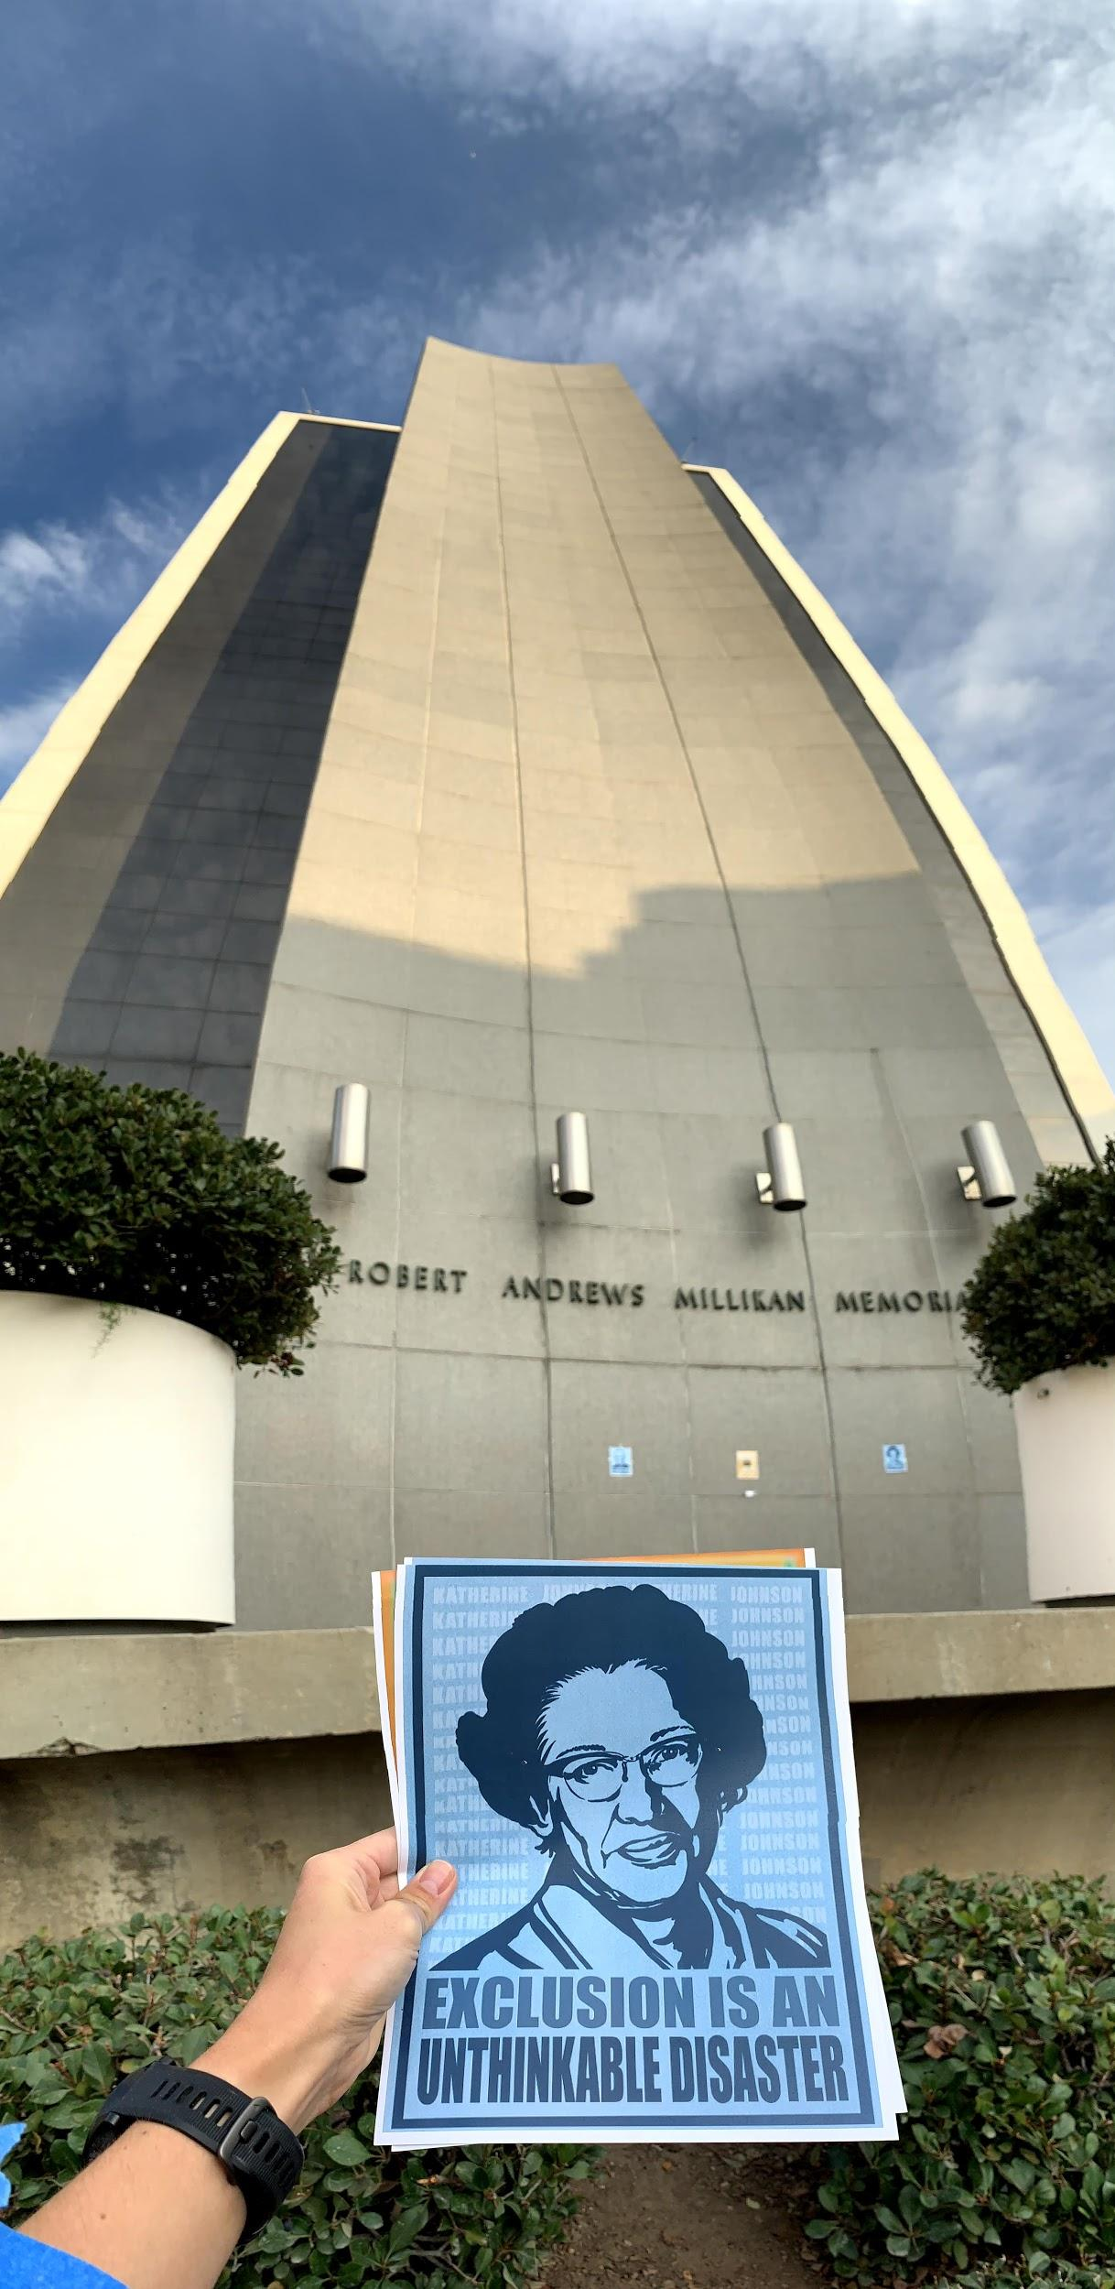
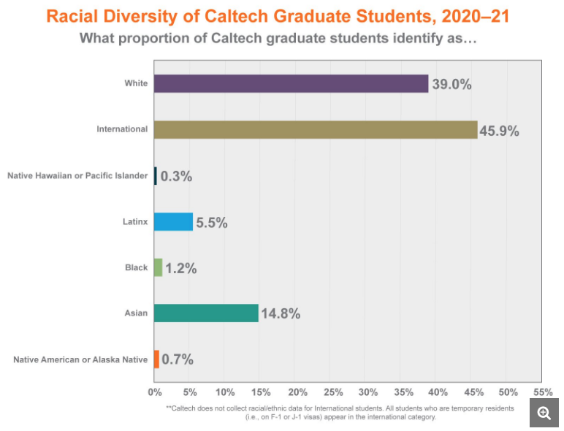
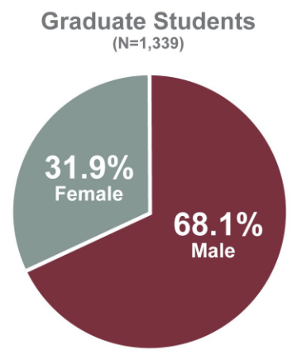
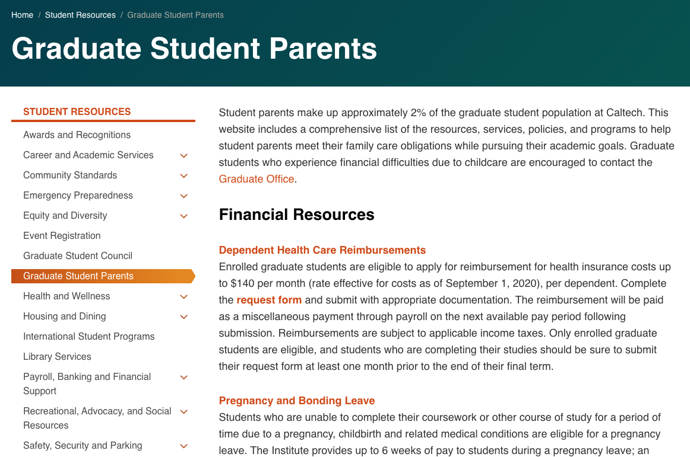
Honoring our Commitment to Honest Recruitment
🚧 Caltech does not have a strong track record for racial or gender equity 🚧
However, there is an active community of scientists here who are highly dedicated to transforming the existing culture, and many in BBE are part of it.
WiBBE Advocacy Tracker:
Additional Stipend Support for Graduate Student Parents ✅
Increase Affordable Childcare Availability for Grad Student and Postdoc Parents 🔜
Inclusive Campus Climate: Rename Buildings Named After Eugenicists 🔂
Spreading the Diversity, Equity and Inclusion Workload by:
Creating a Dedicated DEI Team in the BBE Division ✅
Creating funded awards/fellowship positions for student driven diversity initiatives 🚧
For more details about racism and antiracism at Caltech, visit C4BL: https://caltechforblacklives.com/resources/
↑ https://inclusive.caltech.edu/about/demographic-data#current-gender-diversity

Slide 4
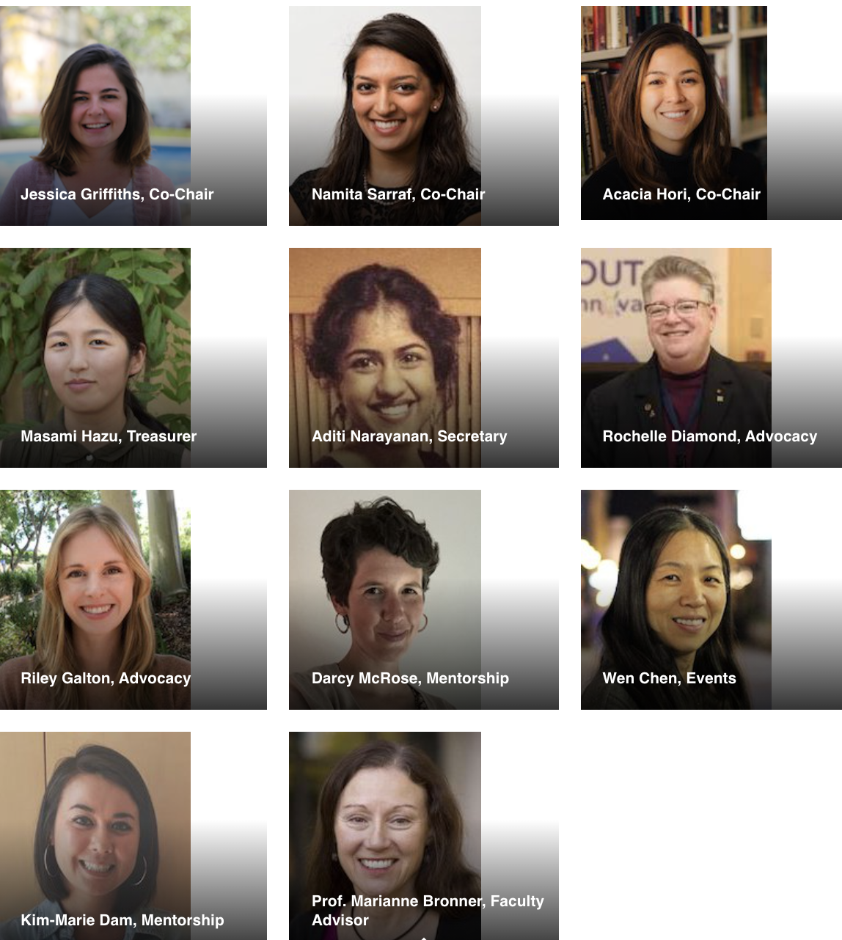
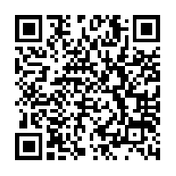
Join our community and expand your impact in
(and enjoyment of) grad school!
Groups we are proud to collaborate with and support:
Best of luck with your application process! Wherever you choose to go, find a community in that place that will help you grow and thrive in science and life!
Other Caltech groups that might interest you: https://caltechforblacklives.com/, http://diversity.caltech.edu/
Notes:
Link to join WiBBE group listserv:
https://forms.gle/ijan8tRur72qVHb6A
Link to request a welcome packet: https://docs.google.com/forms/d/e/1FAIpQLSfbbjbkY0q0rX1uzUEUJLB7zvwC7RtC302Dlc239WMAgy55vw/viewform?usp=sf_link
Link to Slack: https://join.slack.com/t/wibbe/shared_invite/zt-g4lyrv4k-8ikPgHOPPwtFfp4YBMZJmA
Twitter handle: @CaltechWiBBE
Website: http://wibbe.caltech.edu/
Contact us:
-Namita namita@caltech.edu
-Jess jgriffit@caltech.edu
-Acacia acaciaho@caltech.edu

